Slide 1
“Présentation Thomas Huet Ingénieur de recherche en production, traitement et analyse de données au CNRS
IRAMAT-CNRS, Réunion du laboratoire CEB, 03/04/25

Slide 2

“In God we trust. All others must bring data." W. Edwards Deming
La méthode

Slide 3
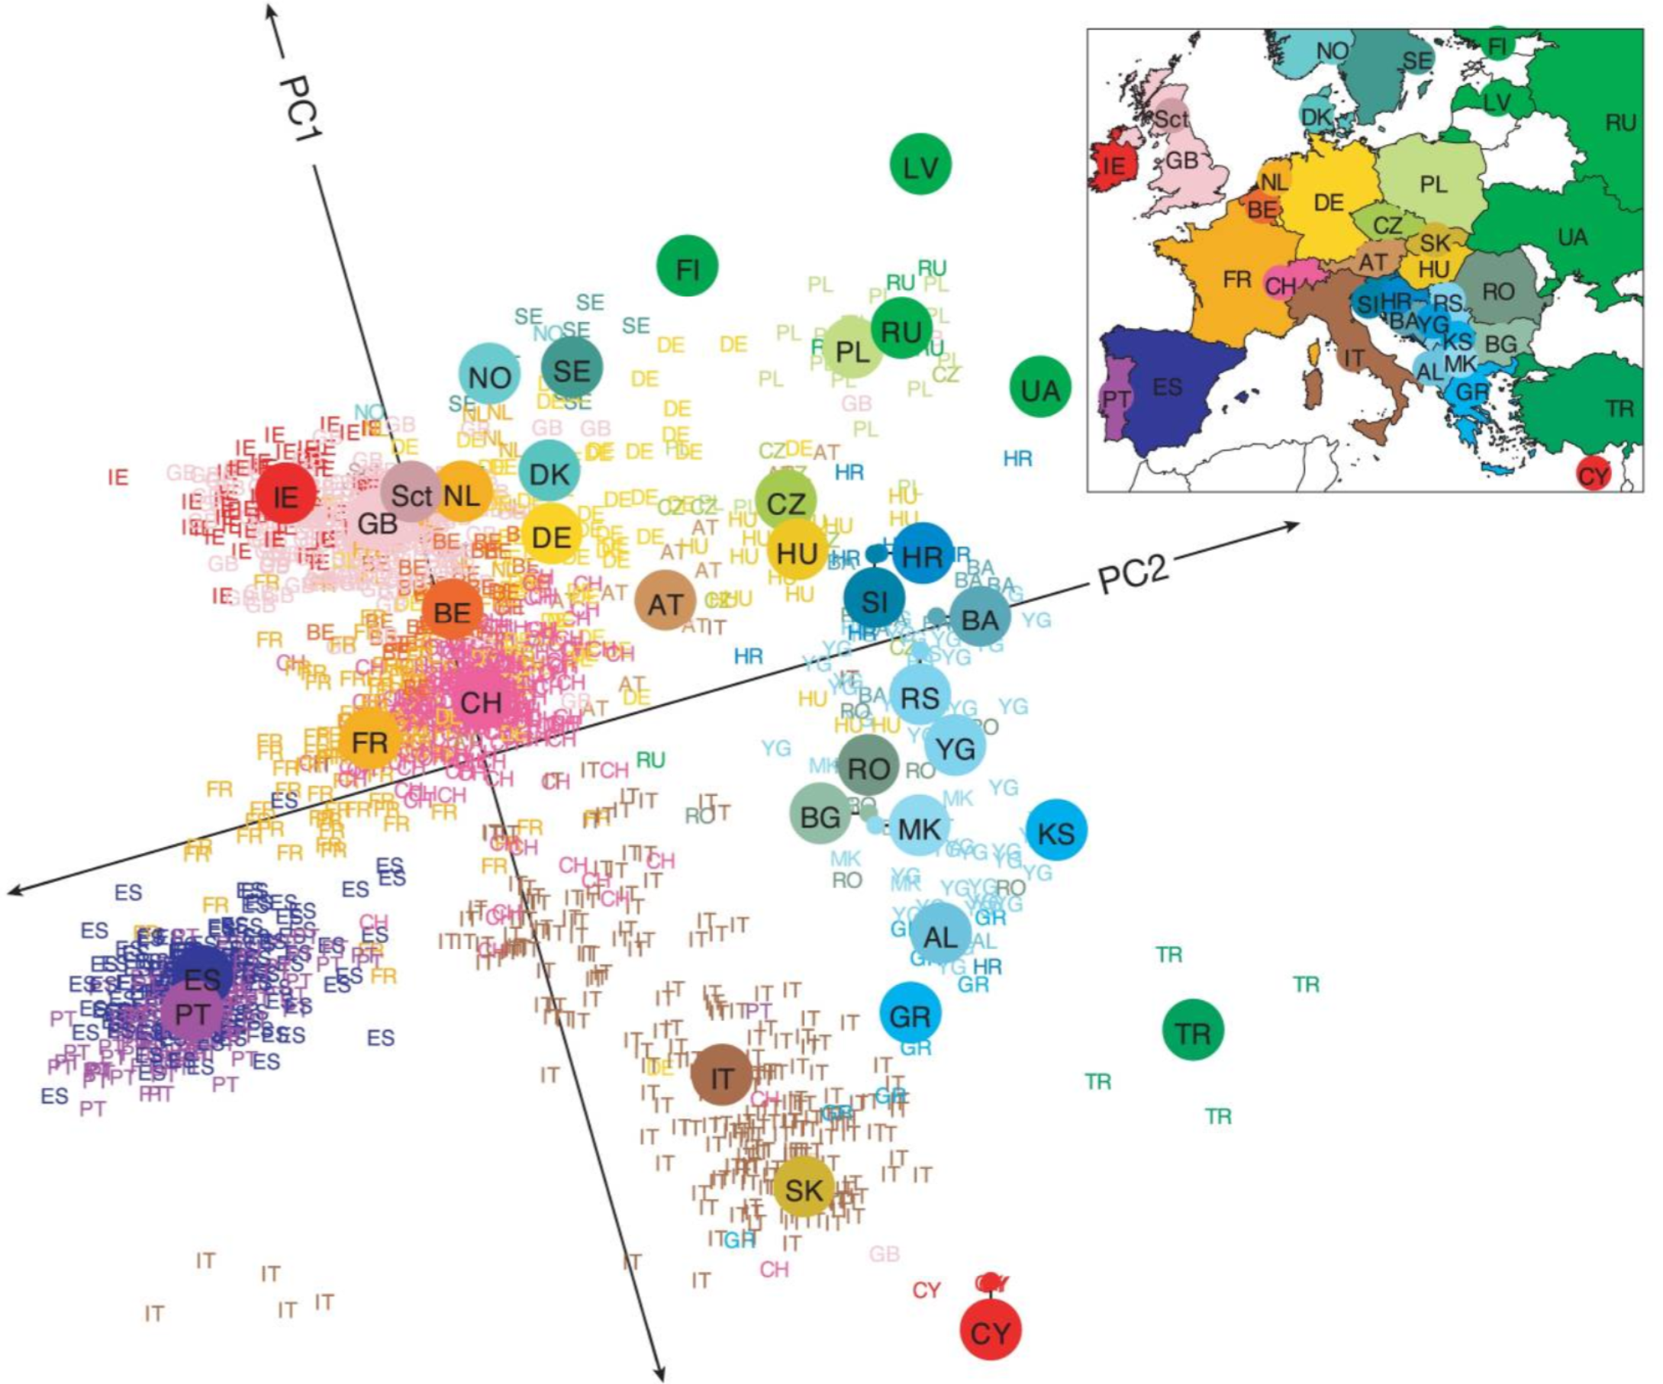
“Everything is related to everything else, but near things are more related than distant things" Waldo Tobler
Les statistiques
Novembre, J., Johnson, T., Bryc, K., Kutalik, Z., Boyko, A. R., Auton, A., ... & Bustamante, C. D. (2008). Genes mirror geography within Europe. Nature, 456(7218), 98-101.

Slide 4
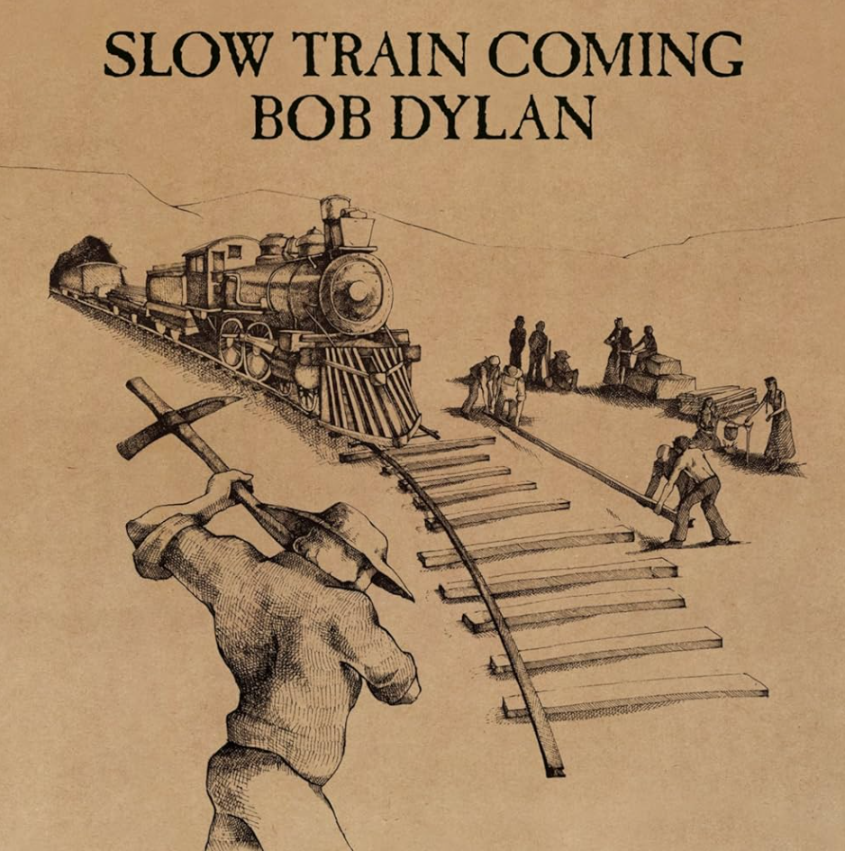
“There are only two hard things in Computer Science: cache invalidation and naming things" Phil Karlton
L’informatique
Dylan, B. (1979). Slow train coming [Album]. Columbia Records.
Tack 8 – “Man Gave Names to All the Animals”

Slide 5
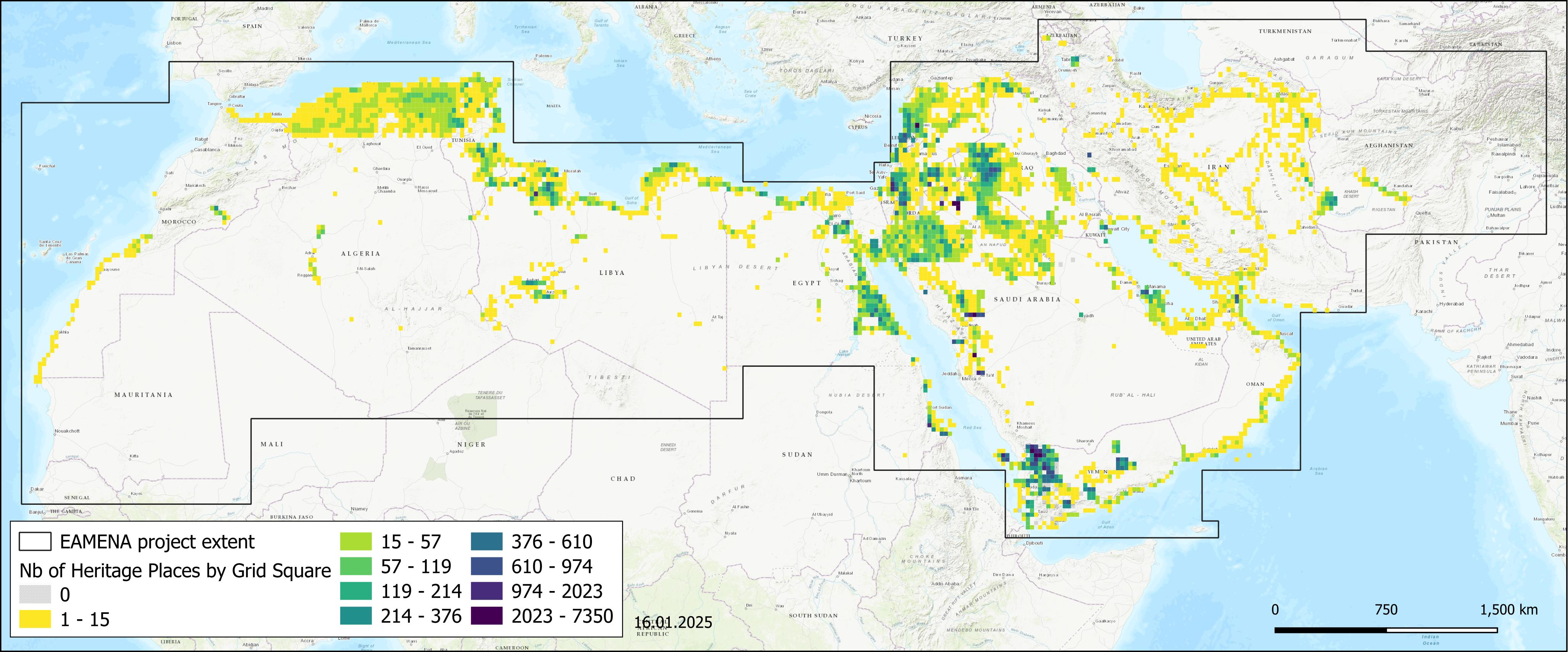
“A relational database is like a spreadsheet on steroids" anonyme
Nombre de Heritage Places par grille de 27,5 x 27,5 km dans la BDD EAMENA 2024

Slide 6
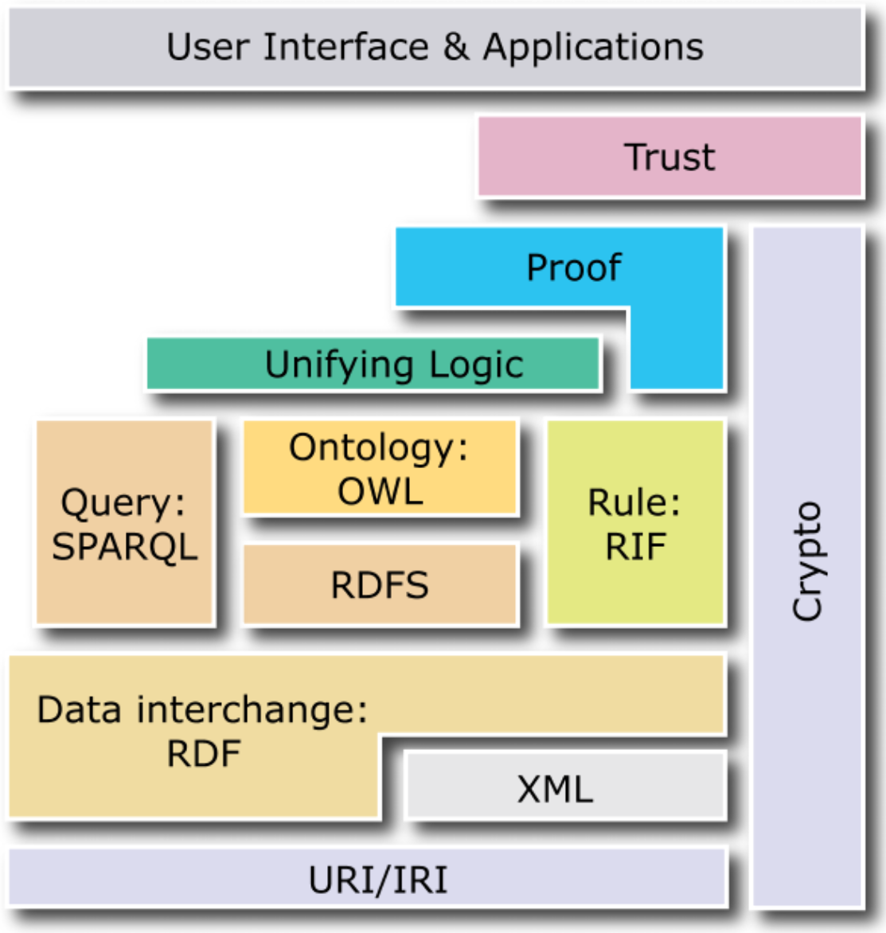
“The semantic web is the future of the internet and always will be" Peter Norvig
Le Web sémantique
La pile logicielle du Web sémantique, https://it.wikipedia.org/wiki/File:W3C-Semantic_Web_layerCake.png

Slide 7
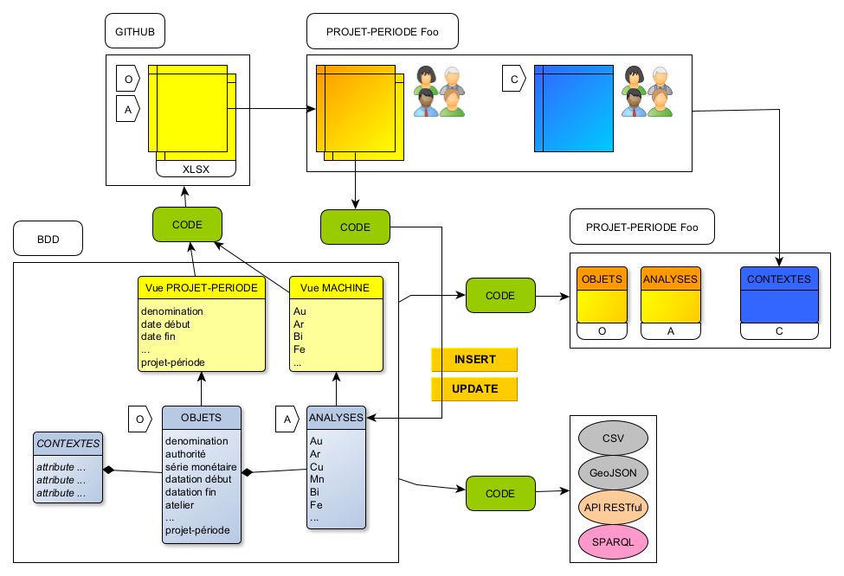

Slide 8





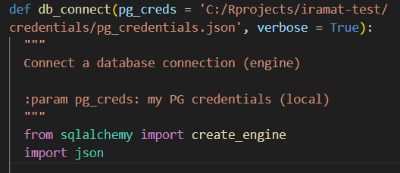



















triplestore

